Slide 1

Unlocking Olympic Data: SQL Insights into Decades of Games
This project focuses on analyzing the 120 years of Olympics history dataset using SQL queries. The dataset consists of two tables: "dataset_olympics.csv" and "noc_region.csv".
The "dataset_olympics" table contains information about athletes, their teams, the Olympic Games they participated in, and the medals they won.
The "noc_region" table provides the mapping between the National Olympic Committee codes (NOC) and the corresponding regions.
By cleaning the dataset using Python and Pandas, the project aims to ensure data quality.
To extract insights based on the questions given, SQL queries will be written in module 2.

Slide 2
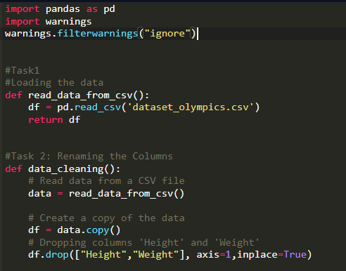
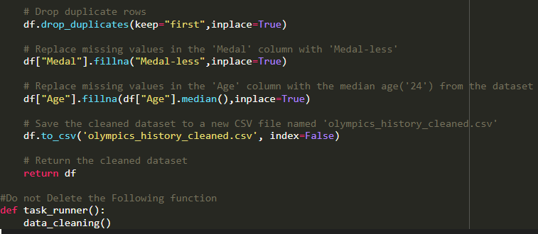
MODULE 1: DATA PRE PROCESSING USING PYTHON
TASK 1:
The initial stage of the project involves preprocessing two distinct datasets that will be used('dataset_olympics' and 'noc_region'). The data cleaning process is crucial before we can proceed to upload these datasets into the

Slide 3
MODULE 1: DATA PRE PROCESSING USING PYTHON
TASK 2:
The data_cleaning() function reads data from a noc_region.csv file and performs cleaning operations on the dataset. It creates a copy of the data and drops the 'notes' column. The function then renames specific columns, such as 'noc_region' to 'NOC' and 'reg' to 'region'. The cleaned dataset is saved to a new CSV file named 'olympics_history_noc_regions_cleaned.csv

Slide 4

MODULE 2: DATA PRE PROCESSING USING PYTHON
TASK 1:
How many olympics games have been held?

Slide 5

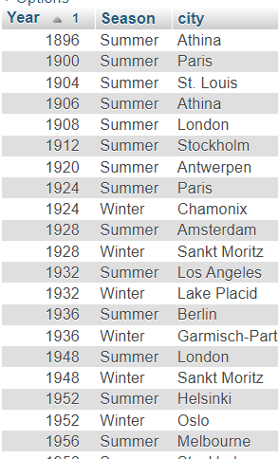
MODULE 2: DATA PRE PROCESSING USING PYTHON
TASK 2:
List down all Olympics games held so far. Order the result by year.

Slide 6

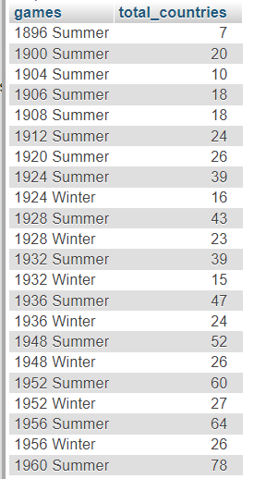
MODULE 2: DATA PRE PROCESSING USING PYTHON
TASK 3:
Mention the total number of nations who participated in each olympics game? Order the results by games.

Slide 7


MODULE 2: DATA PRE PROCESSING USING PYTHON
TASK 4:
Which nation has participated in all of the olympic games?
order the output by first column which is fetched

Slide 8

MODULE 2: DATA PRE PROCESSING USING PYTHON
TASK 5:
How many unique athletes have won a gold medal in the Olympics?

Slide 9

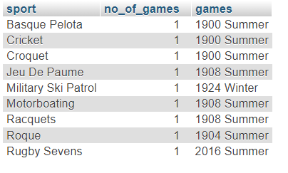
MODULE 2: DATA PRE PROCESSING USING PYTHON
TASK 6:
Which Sports were just played only once in the olympics? Order the output by Sports. output should include number of games.

Slide 10

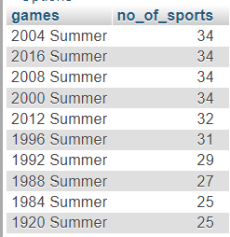
MODULE 2: DATA PRE PROCESSING USING PYTHON
TASK 7:
Fetch the total number of sports played in each olympic games.
Order by no of sports by descending.

Slide 11
MODULE 2: DATA PRE PROCESSING USING PYTHON
TASK 8:
Fetch oldest athlete to win a gold medal.

Slide 12

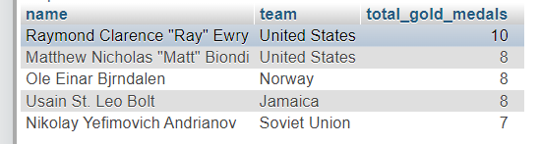
MODULE 2: DATA PRE PROCESSING USING PYTHON
TASK 9:
Top 5 athletes who have won the most gold medals.
Order the results by gold medals in descending.

Slide 13

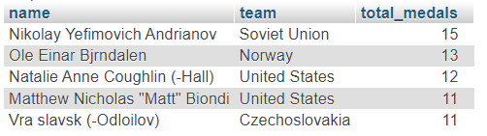
MODULE 2: DATA PRE PROCESSING USING PYTHON
TASK 10:
Top 5 athletes who have won the most medals (gold/silver/bronze). Order the results by medals in descending.

Slide 14
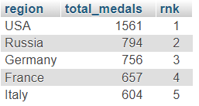
MODULE 2: DATA PRE PROCESSING USING PYTHON
TASK 11:
Top 5 most successful countries in olympics.
Success is defined by no of medals won.

Slide 15

MODULE 2: DATA PRE PROCESSING USING PYTHON
TASK 12:
In which Sport/event, India has won highest medals.

Slide 16

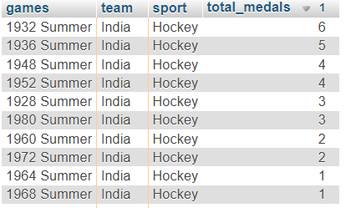
MODULE 2: DATA PRE PROCESSING USING PYTHON
TASK 13:
Break down all olympic games where india won medal for Hockey and how many medals in each olympic games and order the result by no of medals in descending.

